Slide 1
Hotel Booking Demand Analysis Project

Slide 2
Objective
To analyze hotel booking data to identify booking patterns , cancellation trends , customer behavior and revenue insights and to build a predictive model for booking cancellation using Machine Learning.

Slide 3
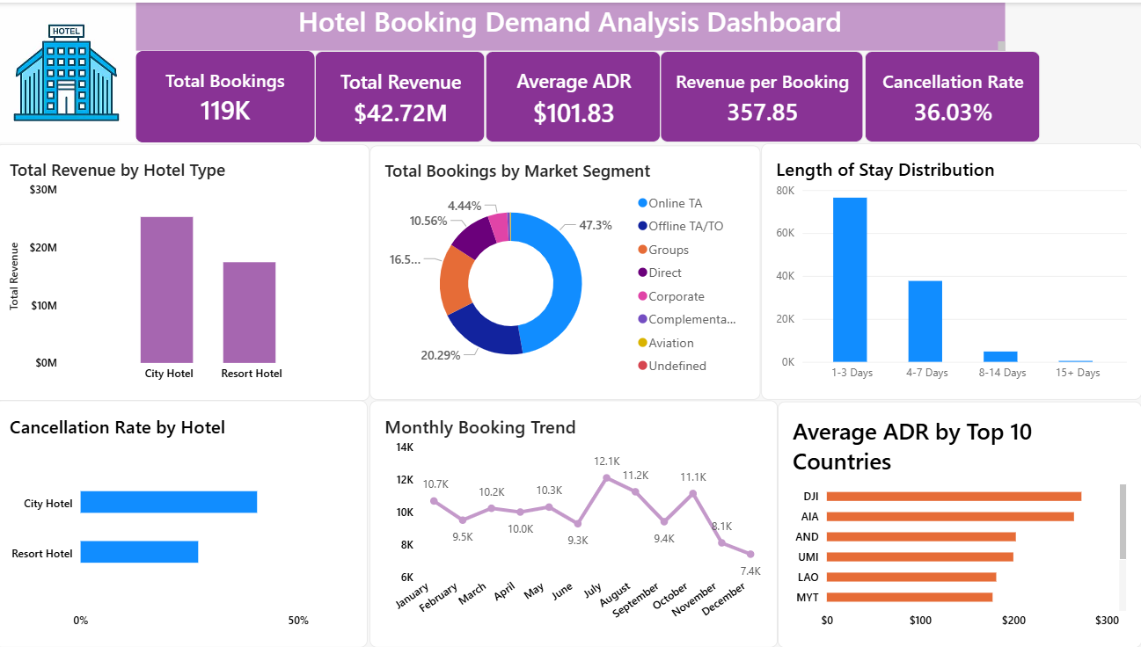

Slide 4
Key KPI’s Used are :
Total Bookings – Shows the total number of hotel bookings made.
Total Revenue – Represents the total revenue generated from bookings.
Average Daily Rate(ADR) – Indicates the avg revenue earned per booking.
Cancellation Rate – Shows the percentage of bookings that were cancelled.
Total Guests – Displays the total number of guests staying in hotels.
Market Segment – Identifies which booking segment contributes the most bookings and revenue.

Slide 5
Different types of Visualizations are:
Total Revenue by Hotel Type – Compares the revenue generated by City Hotel and Resort Hotel.
Helps Identify which hotel type contributes more to overall revenue.
Useful for understanding hotel performance and business growth.

Slide 6
Total Bookings by Market Segment
Shows the distribution of bookings across different market segments.
Helps identify which segment contributes the highest number of bookings.
Useful for understanding customer acquisition sources and business performance.

Slide 7
Average ADR by Top 10 Countries
Displays the average daily room rate for the top 10 countries.
Helps identify countries generating higher room revenue.
Useful for analyzing customer spending patterns and pricing strategy.

Slide 8
Key Insights :
City hotels received the highest number of bookings.
Resort hotels generated higher overall revenue.
Online TA was the leading market segment for bookings.
Adults contributed the highest share of total guests.
Cancellation Rate was higher in City Hotels.
Peak seasons showed higher ADR values.
Longer Stay durations were observed mainly in resort hotels.

Slide 9
Conclusion:
The project analyzed hotel booking trends , customer behavior and revenue performance using Power BI and Machine Learning.
The insights and prediction model can help hotels reduce cancellations and improve business decisions.

